Slide 1
Final Presentation
Team : PassAbility
Sponsor : MG Community Credit Cooperatives
Advisor : Prof. Young Joo Shin

Slide 2
Contents
1. Introduction Team
7. Conclusion
2. Title of the Project
8. Financial Position
3. Overall Schedule
- Date of commencement
- Planned date of completion
- Actual date of completion
4. Project Objectives
- Proposal goals
- Deviation made from original objectives
5. Experimental Works
6. Detailed analysis of Results

Slide 3
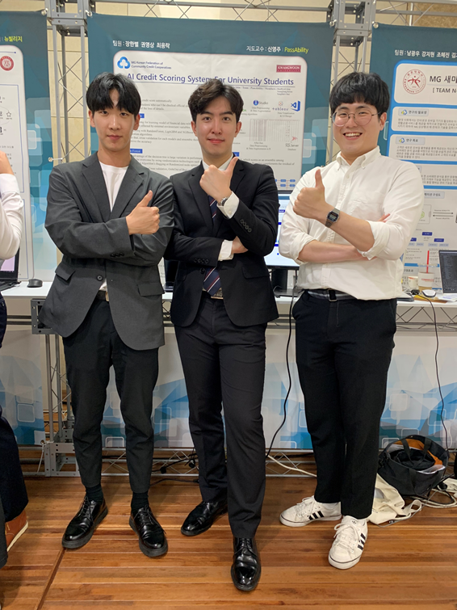
Team leader and Team members
Team Leader : Han Byeol Jang
- Data Preprocessing and Augmentation
Web Design
Team Member : Young Sang Kwon
- Machine Learning Modeling
(RandomForest, XGBoost)
Team Member : Yong Rak Choi
- Machine Learning Modeling
(LightGBM)
- Model Verification

Slide 4




Title of the Project
The Credit Scoring System For university students and rookie in society
Trend
Target
Simulation
The introduction of machine learning in the financial industry
Recognizing the necessity of credit evaluation for university students and rookie in society
University students using banks can be classified by potential credit score

Slide 5




Overall Schedule
Date of commencement
2019. 03. 07
Planned date of completion
2019. 05. 12
Actual date of completion
2019. 05. 14

Slide 6
Overall Schedule
Detailed schedule
March
April
May
1
2
3
4
5
6
7
8
9
10
Data Collection
Data Augmentation
Machine Learning Modeling
Model Verification
Web Implementation

Slide 7
Project Ovjectives
Proposal goals
- More than 90% accuracy
Deviation made from original objectives
- Change evaluation criteria : Accuracy -> RMSE
- Reason : evaluation criteria change and also change the goals
- New goals : Below RMSE 100

Slide 8






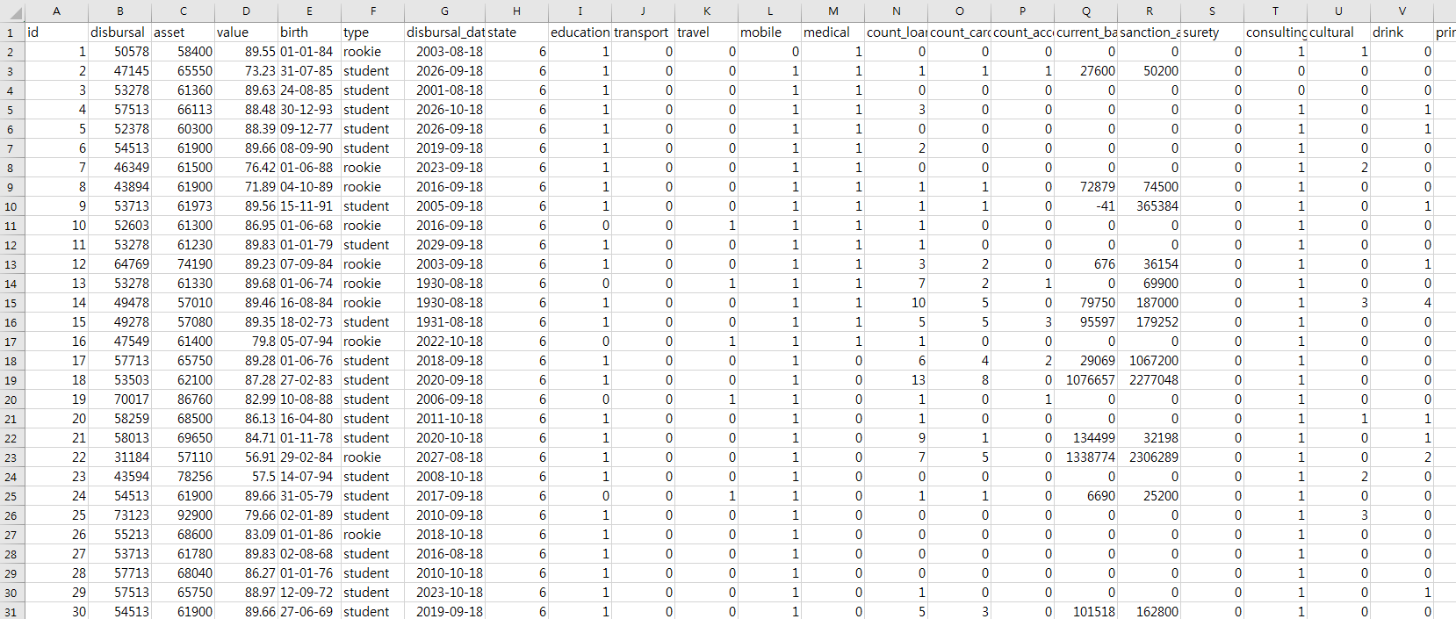
Experimental Works
Data Preprocessing & Data Augmentation
Data Visualization
& UI Design
To get the datasets
of Economics and Finance
For Categorization

Slide 9


Experimental Works
For several machine learning algorithms
Credit scoring with RandomForest, LighGBM and XGBoost that are classification algorithms
After that, cross validation for each models and ensemble them to improve the accuracy
Data Visualization
& UI Design
Result of Ensemble
R(1):X(1):L(3)
RMSE : 127.7531
RandomForest
RMSE : 133.354
XGBoost
RMSE : 131.775
LightGBM
RMSE : 130.810
R(2):X(5):L(3)
RMSE : 127.887
Ensemble
R(2):X(3):L(5)
RMSE : 127.7698

Slide 10
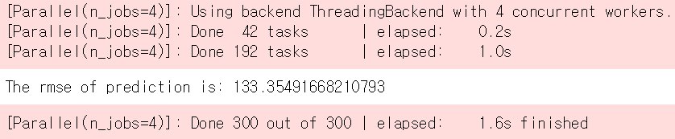
Detailed analysis of Results
RMSE of RandomForest
RMSE of XGBoost
RMSE of LightGBM

Slide 11
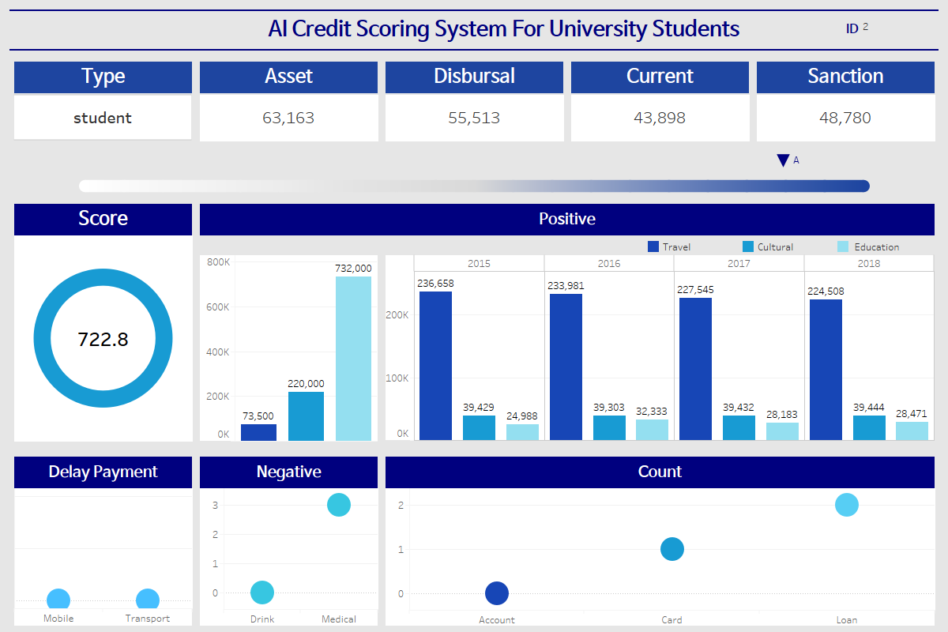
Detailed analysis of Results
UI Design

Slide 12
Detailed analysis of Results
Quantitative Goals
Model | Performance Indicators | Final Object | Objective measurement method |  | Achieve
 |  |  | Training Set | Test Set
Random Forest | RMSE / Time | 100 / 3.0m | 233,154 | 112392 | 133.354 / 5.6m
XGBoost | RMSE / Time | 100 / 2.0m | 233,154 | 112392 | 131.775 / 4.2m
LightGBM | RMSE / Time | 100 / 1.0m | 233,154 | 112392 | 130.81 / 48s
Ensenble (1 : 1 : 3) | RMSE | 100 | 233,154 | 112392 | 127.753

Slide 13
Conclusion
Best Performance
- LightGBM (for speed, accuracy)
Utilization Plans
- Using the AI Credit Scoring System, we can simulate
the credit evaluation of university students in the bank
and classify them to some degrees
=> As a result, It makes more efficient to attract and
manage potential customers who can’t be checked credit
score like university students

Slide 14
Financial Position
No | Financial Position/ Budget Head | Funds Sanctioned (Won) | Expenditure (Won) | % of Total cost
 | Salaries/ Manpower cost | 100,000 | 60,000 | 3%
 | Equipment | 300,000 | 100,000 | 5%
 | Supplies & Material | 500,000 | 300,000 | 15%
 | Contingencies | 0 | 0 | 0
 | Travel | 0 | 0 | 0
 | Overhead Expenses | 0 | 0 | 0
 | Others, if any | 1,100,000 | 0 | 0
 | Total | 2,000,000 | 460,000 | 23%

Slide 15
Q n A

